Slide 1


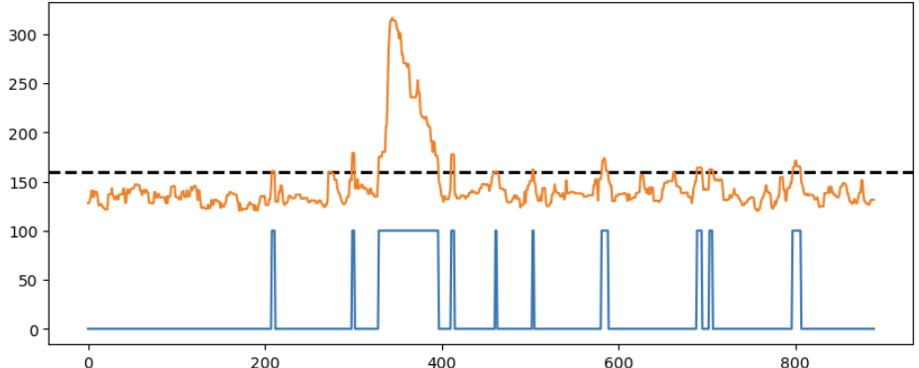
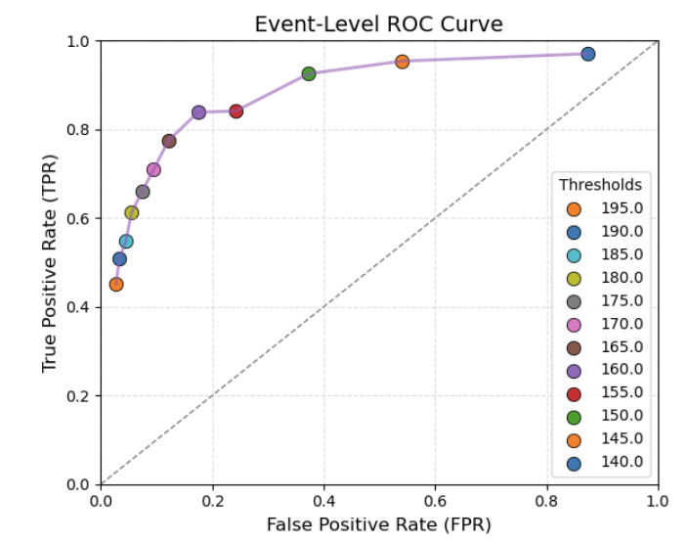
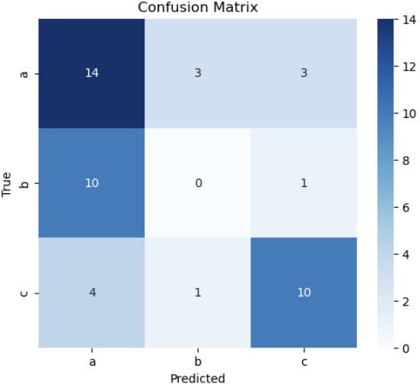
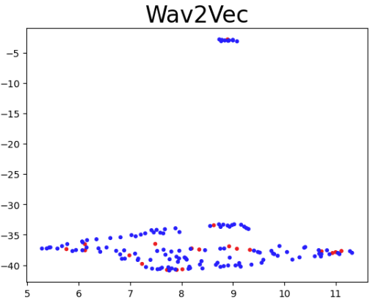
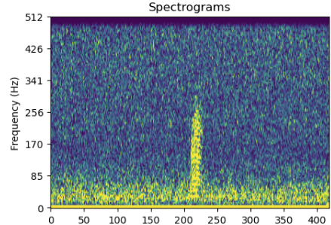
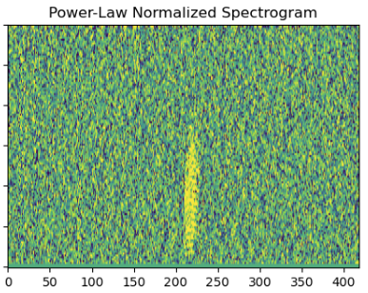
Few Shot Bioacoustic Event
Detection in Freshwater Soundscapes
Felicia Huffman¹*, Evan Lucas¹, Rosalyn Putland²
Michigan Technological University
Cefas
* Corresponding Author: fmhuffma@mtu.edu
Summary:
We built a Machine Learning model to detect the presence of fish calls and group similar calls together. This is critical to analyzing the importance of fish communication.
This method can be applied to other areas of acoustics and could significantly enhance the manual labeling process.
Binary Event Classifier/Detector:
Goal: Find candidate events
Used Threshold tuning to choose threshold for candidates
Candidates were all clips > threshold
Binary Classifier (Blue Spike = Detection)
Multiclass Classifier
Acoustic Embeddings
Goal: determine the species group of the candidate events
Used a ResNet18 Model
Achieved a validation accuracy of ~60%
We wanted to see if there was linear separation between classes when mapped to a vector
Results
We found that embeddings cannot capture the unique pattern of fish calls when sampling at 24k Hz
Few-shot detection may be a viable solution to tedious manual labeling
In the future, ideas like this could be implemented to replace or make the manual labeling process significantly more efficient
Power Law transformation:
Designed to suppress broadband noise
Essentially filters for unique events
Very small labeled dataset
Assumes there are only 5 fish calls, but that is not the case
No species labeling
Frequency
Limitations
Frame Index
References
R. L. Putland, J. A. Austin, C. S. Hill, and A. F. Mensinger, “A song of ice and vessels: Seasonal trends in the soundscape of the western arm of Lake Superior,” J. Great Lakes Res., vol. 48, no. 2, pp. 478–488, 2022, doi: 10.1016/j.jglr.2022.01.003.
T. A. Helble, G. R. Ierley, G. L. D’Spain, M. A. Roch, and J. A. Hildebrand, “A generalized power-law detection algorithm for humpback whale vocalizations,” J. Acoust. Soc. Am., vol. 131, no. 4, pp. 2682–2699, Apr. 2012, doi: 10.1121/1.3685790.

